Slide 1
DRAFT
New Ticket Price Estimation:
Using Data Science Methods for Big Mountain Ski Resort
Farid Javadnejad
_{Aug 2022}

Slide 2
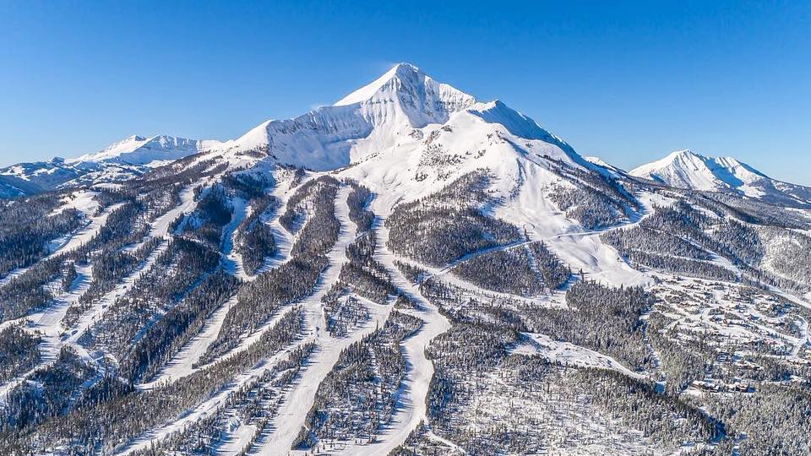

Index
Problem identification
Recommendation & key findings
Modeling results & analysis
Summary & conclusion
DRAFT
2
aerogeospatial.com

Slide 3
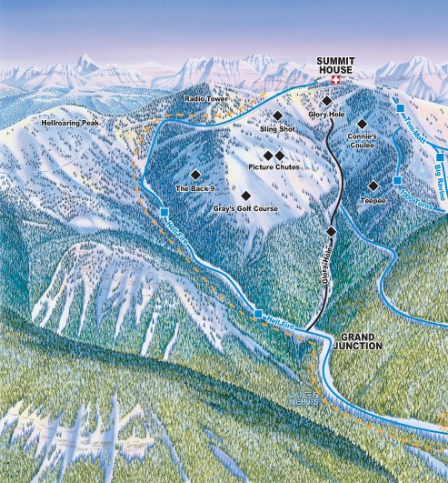
Problem identification
Context
Big Mountain Resort is a ski resort in Montana.
It serves nearly 350,000 skiers every year.
Recently, the resort has recently installed an additional chair lift
The project operating costs of $1.540M this season.
The resort needs to adjust its finances to accommodate the cost
By increasing the ticket price
By cutting other costs of facility
DRAFT

Slide 4
Problem identification
Criteria for success
Solution space
Solution Constraints
Key data sources
Setting pricing to cover the new $1.540M cost
Identifying the areas to cut the cost
Competitive analysis with 300 ski resorts in the country
Use direct competition to set price.
Consider cutting other operational costs
New ticket price should be comparable to the competition
The business should be ensured.
Data for 300 similar ski resorts in the country
Ticket price
Number of chair lifts
Number of terrain parks
Length of the longest run
Base elevation
Summit elevation
Vertical drop
etc.
DRAFT

Slide 5
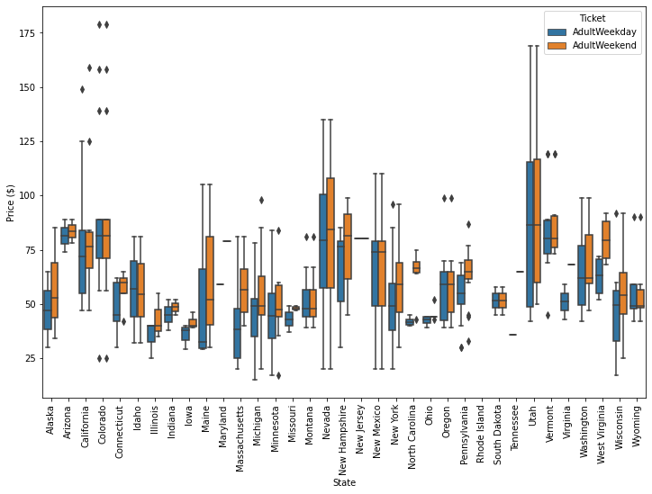
Recommendation & key findings
Important operational and business-related information for 330 ski resorts was collected.
277 resorts that included all features of interest was used for further analysis.
The ticket price for the resorts ranged from $25 – over $100.
We combined the resort specific data with state features.
A total of 32 numerical features was be used to model the ticket prices.
DRAFT

Slide 6
Modeling results & analysis
Model
Choosing a Model
Modeling Scenarios
Deployed models:
Linear regression
Random forest regression
Dependent & Intendent Features
Dependent feature (to predict): Ticket price
Independent features (use to predict): Other features
Train-test sets
70-30 train and test sets split
Determined in an automated pipeline of
Cross-validation
Hype-parametrization techniques
Best Performance Model
Random forest model performance for
Train MAE = 9.65±1.47
Test MAE = 9.43.
Used the best model to study a number of scenarios:
Close the least used runs
Add one run to increase the vertical drop by 150 ft, and installing a chair lift to support it
Add 2 acres of snow making to 2rd scenario
Increase the longest run by 0.2 miles and add 4 acers of snow making capacity.
DRAFT

Slide 7
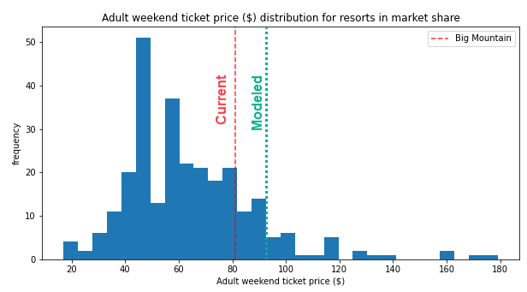
Modeling results & analysis
Our modelled price suggests the new price of $94.26
Big Mountain resort currently charges $81 for adult ticket in the weekends.
The modelled price is supported by the facilities that Big Mountain provides in the market place
In national scale, Big Mountain is already one of the most expensive resorts; however, the $13 increase in ticket price will not dramatically change its position in the in the league
DRAFT

Slide 8
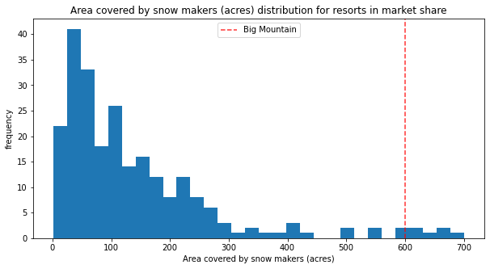
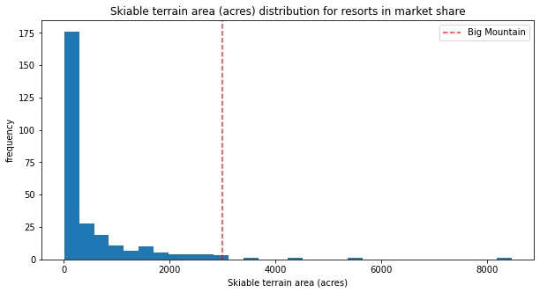
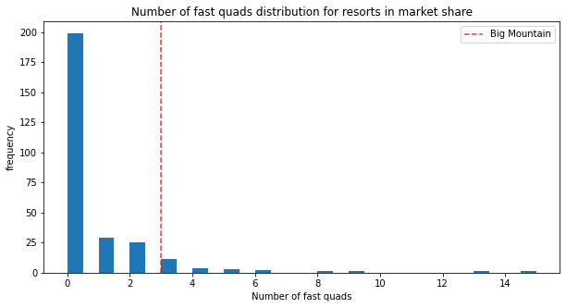
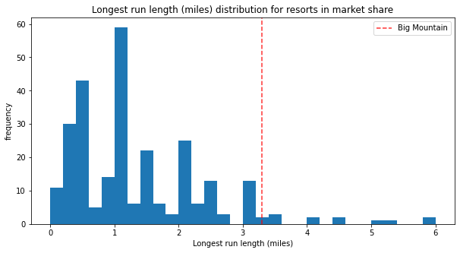
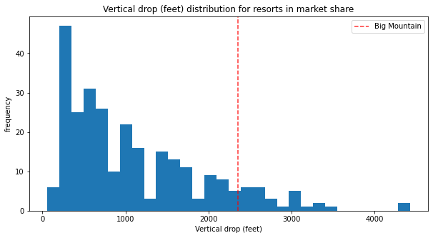
Modeling results & analysis
Big Mountain is one of countries top resorts with large snow making area, skiable terrain, number of fast quads, longest runs, and vertical drop.
DRAFT

Slide 9
Summary and conclusion
The operating cost of the new chair lift is $1.540M in the season.
Ticket price should to rise at least $4.4 to $85.4 to cover this operating cost.
The modelled price suggests the new price of $94.26
It would be $13.26 more than the current price of $81.
Which meets the required $4.4 increase
The 2nd scenario found to have the best review support ticket price by $1.70.
The scenario suggest to add 1 run, increase the vertical drop by 150 feet, and install an additional chair lift,
Over the season, this could be expected to amount to $2.967M. The new revenue is larger than the new operational cost.
It is also suggested to close 1 run
It doesn’t impact the ticket price or revenue
It will help to reduce the maintenance costs.
DRAFT

